Slide 1


SAP S/4HANA Training
MASTER DATA GOVERNANCE (SAP MDG)
Neeraj Gupta
Session 27
SAP MDG – Consolidation Process

Slide 2
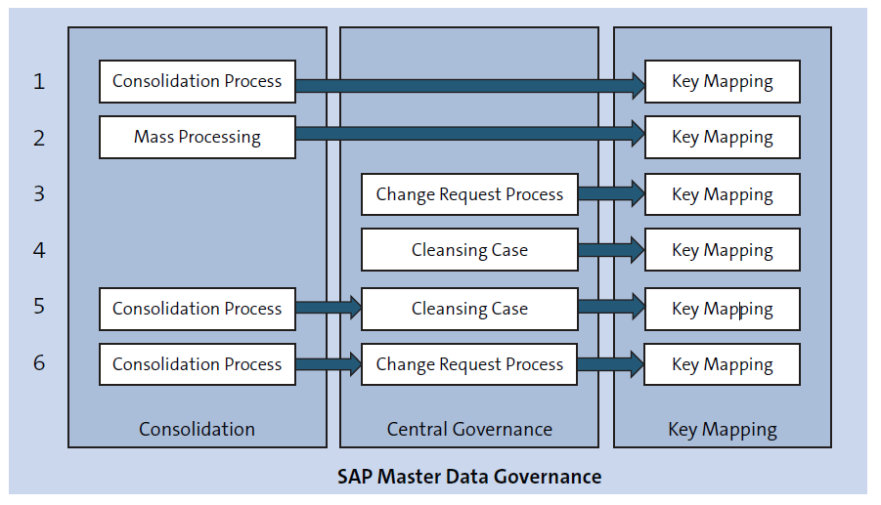
Consolidation and Central Governance Use cases
27
SAP MDG – Consolidation and Mass Processing

Slide 3
Setup steps for Consolidation and Mass Processing SFW5
27
SAP MDG – Consolidation and Mass Processing

Slide 4
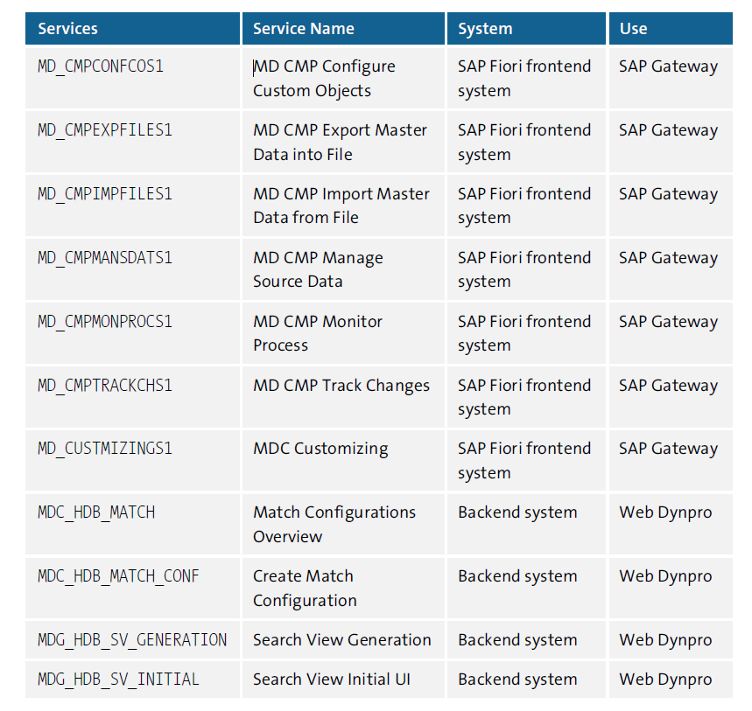
Setup steps for Consolidation and Mass Processing SICF
27
SAP MDG – Consolidation and Mass Processing

Slide 5
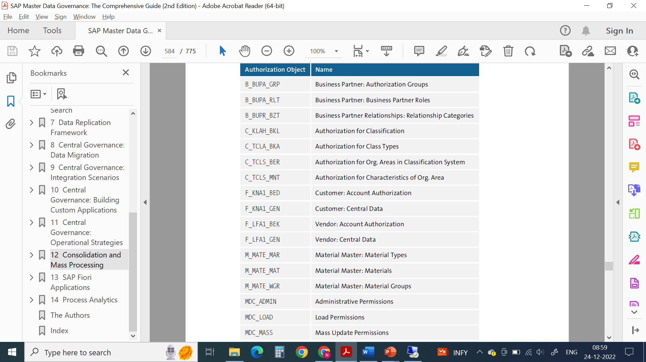
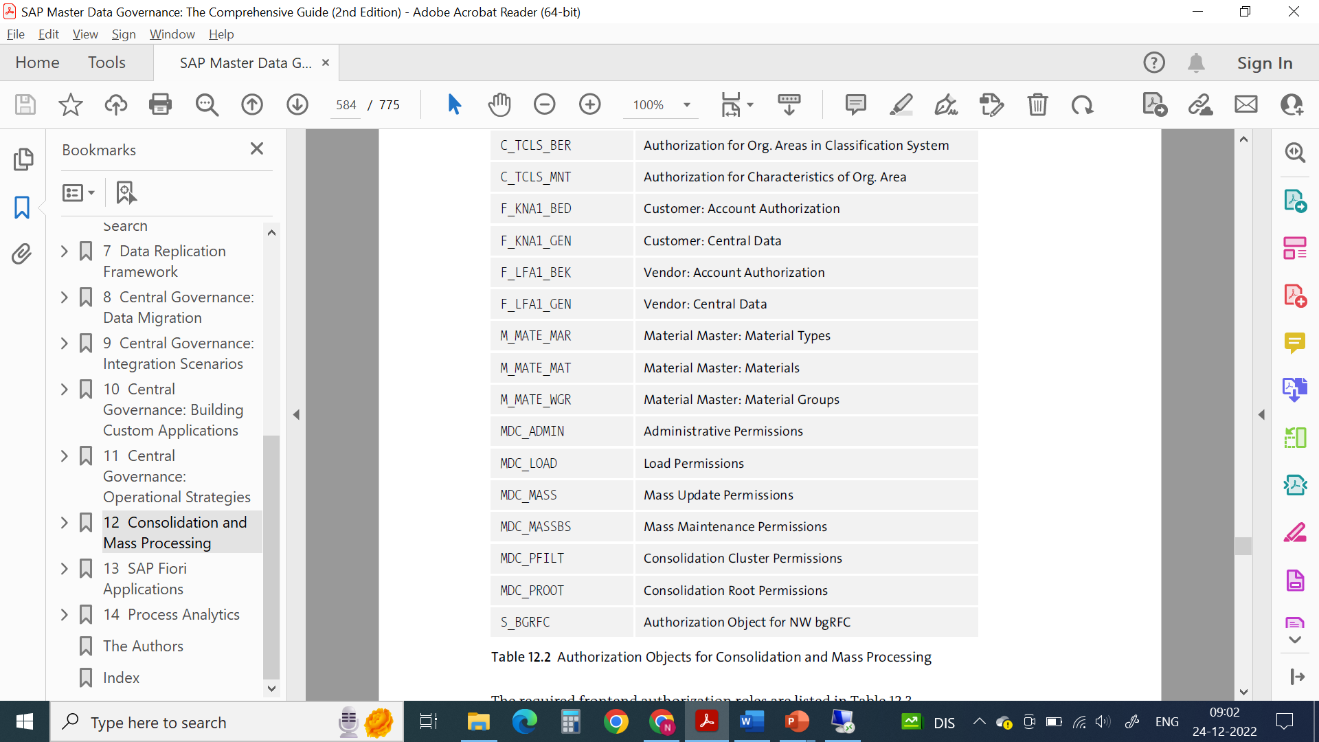
Authorization Objects
27
SAP MDG – Consolidation and Mass Processing

Slide 6
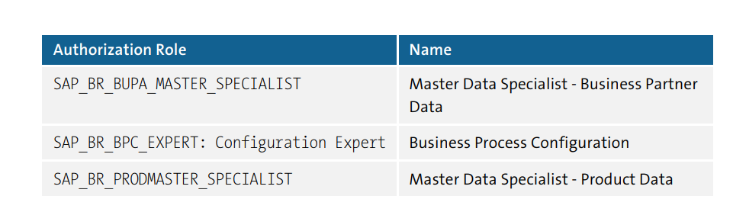
Frontend Authorization Roles
27
SAP MDG – Consolidation and Mass Processing

Slide 7
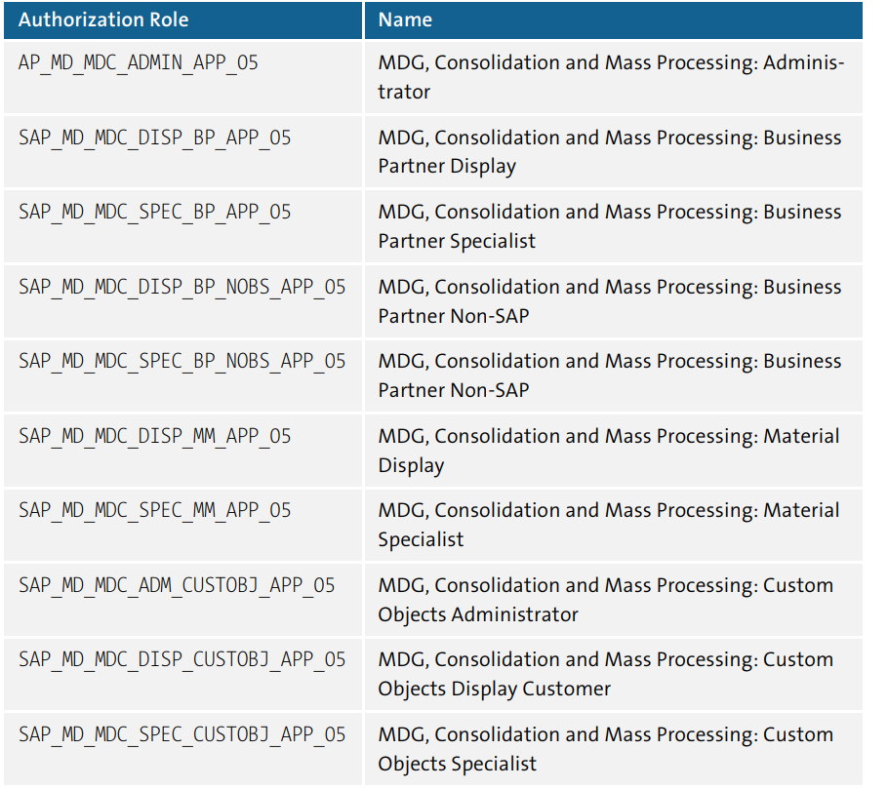
Backend Authorization Roles
27
SAP MDG – Consolidation and Mass Processing

Slide 8
Permissions / Privileges for SAP HANA
27
SAP MDG – Consolidation and Mass Processing
Permissions required to work with views and rulesets in SAP S/4HANA
Create packages and write objects into packages
Create, change, and drop attribute views
Create, change, and drop SQL views
Create, execute, and drop rulesets
Privileges to work with views and rulesets in SAP S/4HANA
Execute for the EXECUTE_SEARCH_RULE_SET(SYS) object of the SYS schema
Execute for the GET_PROCEDURE_OBJECTS object of the SYS schema
Execute for the TRUNCATE_PROCEDURE_OBJECTS object of the SYS schema
Basic Configuration for bgRFC (Web Services)
AUTOABAP
Remote function call (RFC)
Background RFC (bgRFC)
Internet Communication Network (ICF)

Slide 9
Identification of Business System
27
SAP MDG – Consolidation and Mass Processing
System Landscape Directory (SLD)
Business Add-In (BAdI) MDG_IDM_GET_LCL_SYSTEM
Set Up the Workflow
Standard workflow template WS54500001 for consolidation and mass processing
Linkage type activation needed
Linkage Activated checkbox must be unchecked for other receiver types of the BUS2240 object type and the STARTED event
Receiver Type Function Module “MDC_RECEIVER_TYPE_GET”
Receiver Function Module “SWW_WI_ CREATE_VIA_EVENT_IBF”

Slide 10
SAP-Delivered Process Models
27
SAP MDG – Consolidation and Mass Processing
Business partner (BO type 147)
Business partner relationships (BO type 1405)
Business partner for consolidation (BO type MDC_147)
Material (BO type 194)

Slide 11
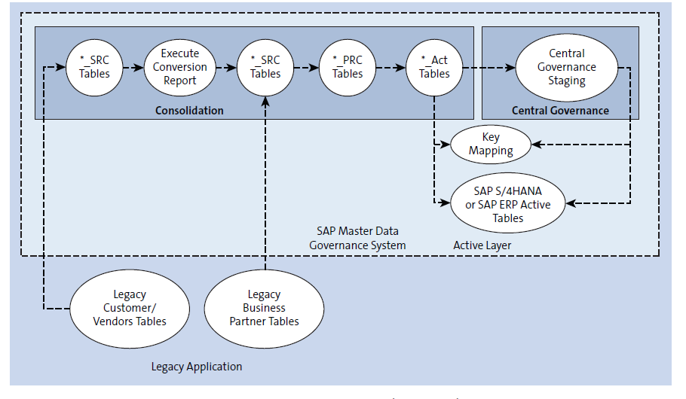
Table Types
27
SAP MDG – Consolidation and Mass Processing

Slide 12
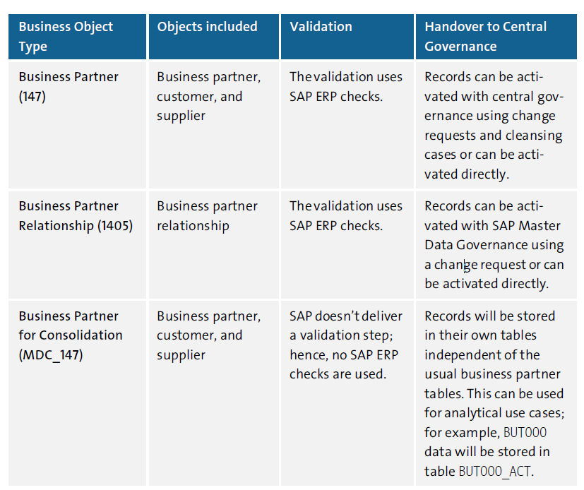
Standard BP Business Objects in MDC
27
SAP MDG – Consolidation and Mass Processing

Slide 13
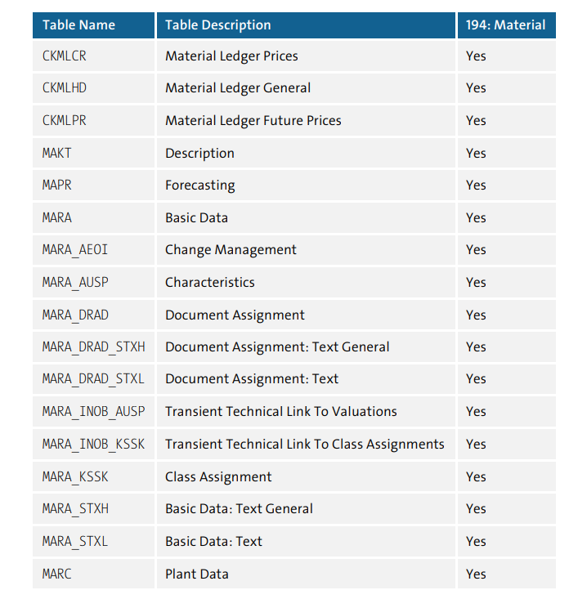
Standard Material Object in MDC
27
SAP MDG – Consolidation and Mass Processing

Slide 14
Standard Material Object in MDC
27
SAP MDG – Consolidation and Mass Processing

Slide 15
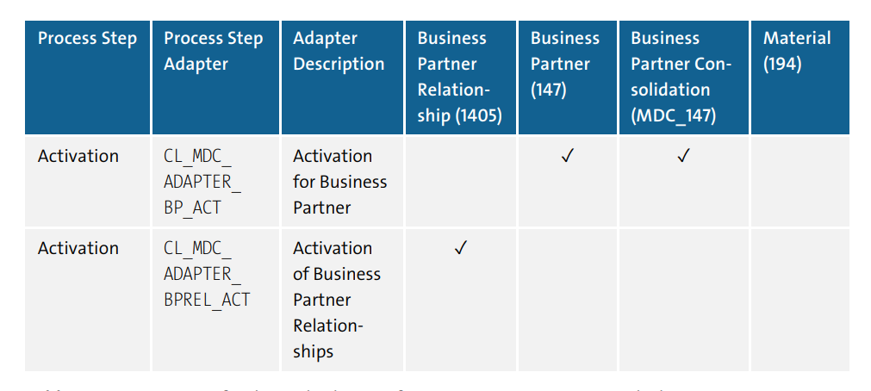
Adapters (Process steps + Object Types)
27
SAP MDG – Consolidation and Mass Processing

Slide 16
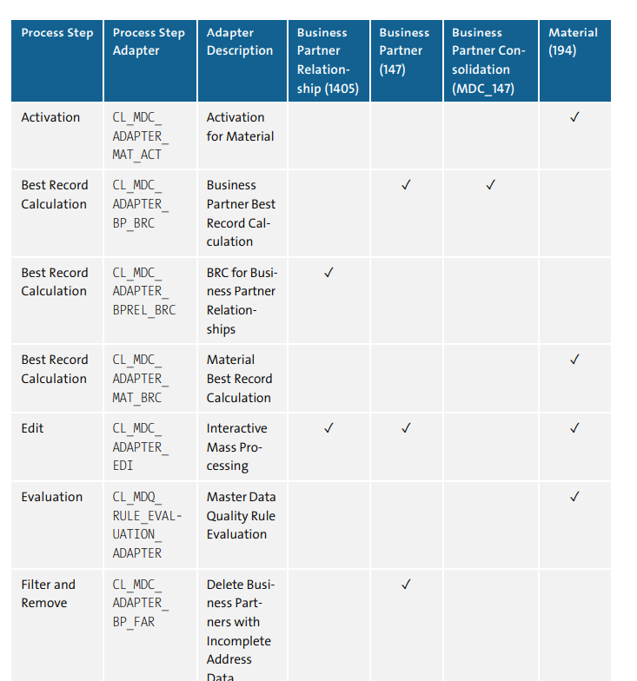
Adapters (Process steps + Object Types)
27
SAP MDG – Consolidation and Mass Processing

Slide 17
Process steps in consolidation and mass processing
27
SAP MDG – Consolidation and Mass Processing
Standardization
Enrichment - e.g. Enrichment process fills in the missing field value to postal code
Normalization – e.g. Converting a value of a street name from “Crescent Plaza Dr.” to “Crescent Plaza Drive”
Adapters (Standardization adapters for BRFplus, Business Address Services (BAS), key mapping, and value mapping is maintained)
CL_MDC_ADAPTER_BPREL_STD_VALM (Value Mapping for Business Partner Relationships)
CL_MDC_ADAPTER_BP_IM_STD (SAP HANA smart data quality)
CL_MDC_ADAPTER_BP_KEY_MAP_STD (Evaluate Key Mapping for Business Partners and SAP ERP Customers/Vendors)
CL_MDC_ADAPTER_BP_VALUEMAP_STD (Evaluate Value Mapping for Business Partners and SAP ERP Customers/Vendors)
CL_MDC_ADAPTER_BRF_STD (Business Partner Standardization with BRFplus)
CL_MDC_ADAPTER_MAT_KEY_MAP_STD (Evaluate Key Mapping for Material)
CL_MDC_ADAPTER_MAT_VALUEMAP_STD (Evaluate Value Mapping for Material)

Slide 18
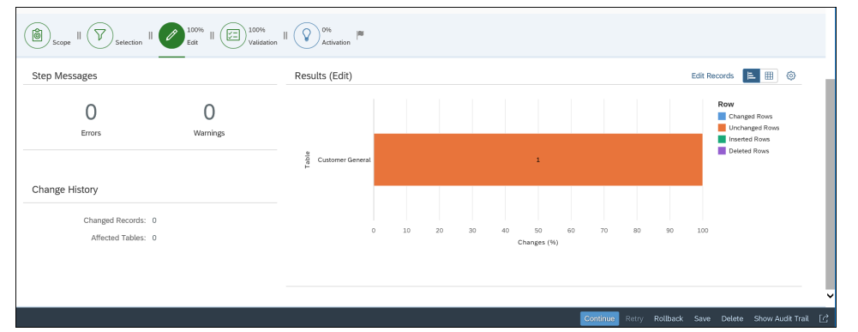
Process steps in consolidation and mass processing
27
SAP MDG – Consolidation and Mass Processing
Update and Edit
Performs BRFplus-based checks and data enrichments in consolidation and mass processing to improve the data quality
Adapter CL_MDC_ADAPTER_BRF_UPD (BRFplus)
Adapter CL_MDC_ADAPTER_EDI (Interactive Mass Processing)

Slide 19
Process steps in consolidation and mass processing
27
SAP MDG – Consolidation and Mass Processing
Matching
Check and compare data from various source applications and the active area with the purpose of identifying potential duplicates
Adapters
CL_MDC_ADAPTER_BPREL_MTC (Matching of Business Partner Relationships)
CL_MDC_ADAPTER_BP_IM_MTC (SAP HANA smart data quality)
CL_MDC_ADAPTER_FUZZY_MTC (SAP HANA Fuzzy Search)
CL_MDC_ADAPTER_MAT_MTC (Material Matching – Old Number)
CL_MDC_ADAPTER_MTC (New SAP HANA Fuzzy Search)
CL_MDC_ADAPTER_986_MTC (New SAP HANA Fuzzy Search)
Match Configurations for Fuzzy Matching
Matching master data records while using fuzzy match

Slide 20
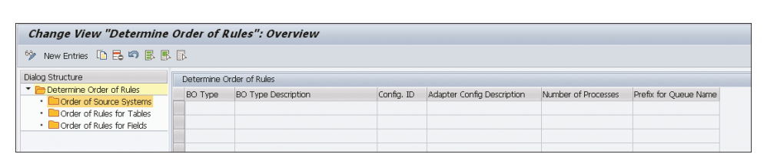
Process steps in consolidation and mass processing
27
SAP MDG – Consolidation and Mass Processing
Best Record Calculation
A best record containing the cumulated, most valuable data for each match group identified by the matching process step
Adapters
CL_MDC_ADAPTER_BP_BRC (Business Partner Best Record Calculation) CL_MDC_ADAPTER_MAT_BRC (Material Best Record Calculation)
Specifying the Order of Rules for Best Record Calculation

Slide 21
Process steps in consolidation and mass processing
27
SAP MDG – Consolidation and Mass Processing
Validation
checks the quality of the record to determine if the master data is good enough to meet requirements in the target connected system
Adapters
CL_MDC_ADAPTER_BP_VAL (Business Partner Validations [SAP Business Suite]) CL_MDC_ADAPTER_MAT_VAL (Material Validations)
CL_MDC_ADAPTER_BPREL_VAL (Validation of Business Partner Relationships)
Inherits the following data quality checks
Existence checks for reference fields of master data records, such as currency, plants, regions, and so on
Simple checks, such as address formats, postal code lengths, and so on
BRFplus modeled business rules and checks
BAdI-based business rules and checks

Slide 22
Process steps in consolidation and mass processing
27
SAP MDG – Consolidation and Mass Processing
Filter and Remove
Filter and remove the unnecessary data during various process steps in consolidation. Can be configured only as a successor of matching, best record calculation, or validation
Adapters
CL_MDC_ADAPTER_BP_FAR (Delete Business Partners with Incomplete Address Data)
CL_MDC_ADAPTER_FAR (Filter and Remove)

Slide 23
Process steps in consolidation and mass processing
27
SAP MDG – Consolidation and Mass Processing
Activation
Final step in the consolidation process where master data will be added in the active area
Records already existing in the active area and hence being updated
Records that neither exist in the active area nor have any duplicates
Records that don’t exist in the active area but do have potential duplicates
Adapters
CL_MDC_ADAPTER_BP_ACT (Business Partner Activation in Consolidation)
CL_MDC_ADAPTER_MAT_ACT (Activation for Material)
CL_MDC_ADAPTER_BPREL_ACT (Activation of Business Partner Relationships)

Slide 24
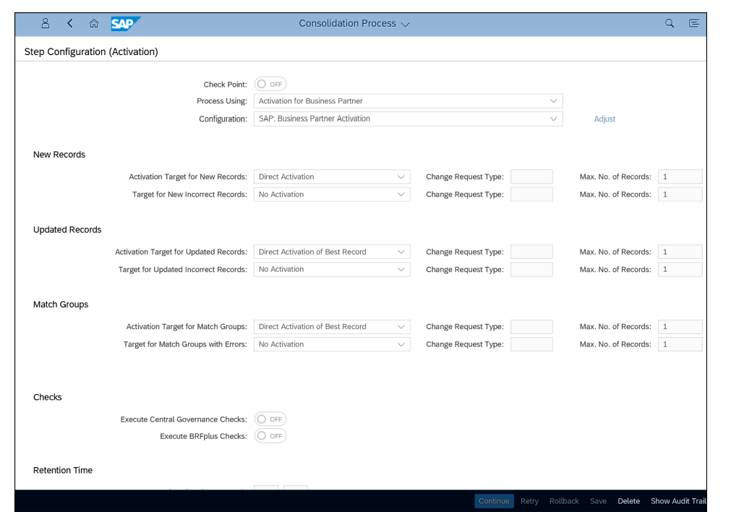
Process steps in consolidation and mass processing
27
SAP MDG – Consolidation and Mass Processing
Activation

Slide 25
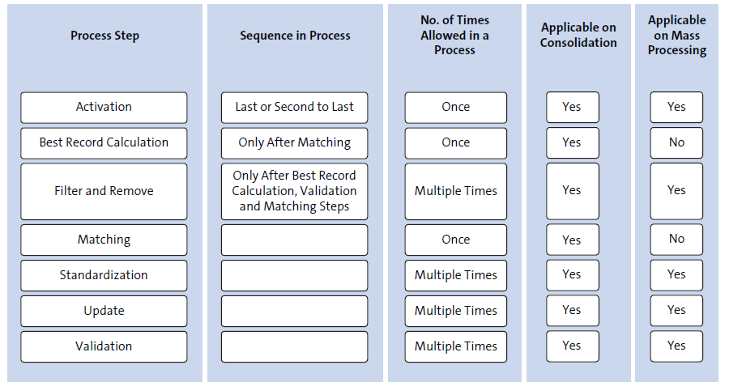
Process Template Design Principles
27
SAP MDG – Consolidation and Mass Processing

Slide 26
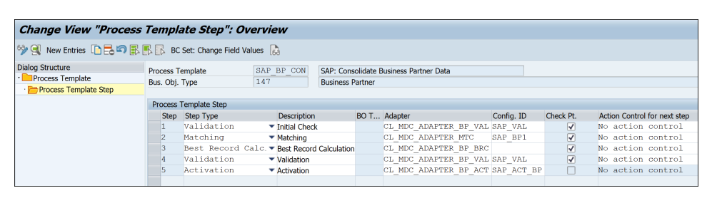
Process Template Design Principles
27
SAP MDG – Consolidation and Mass Processing
Checkpoint checkbox (Check Pt.)
Action Control for the next step
No action control
Apply the four-eyes principle
Action is only allowed for requestor
Authorization object MDC_PROOT
Activity 31 Confirm has to be assigned to continue the process
Activity 37 Accept has to be assigned to continue the process despite unfinished match reviews

Slide 27

End of Session 27

Slide 28

Questions

Slide 29

Neeraj Gupta

Slide 30


We’re committed to empower you to be
Most Desirable Resource
through powerful training solutions.
We build the workforce of the future.
250+
Corporate Clients
30,000+
Learners Trained
25000+
Learners Placed
FREE WEBINARS
Sign up for free webinars with industry experts every fortnight!
Enroll Now!
Contact us today!
https://anubhavtrainings.com/

Slide 31




More from AnubhavTrainings.com

